Slide 1
Project Presentation of Industry Oriented Hands on Experience (22CS422)
On
OPTIMIZING EMOTION RECOGNITION USING EFFICIENT
NUREAL NETWORK
Aditya Bisht
2210990061
Supervised By
Dr. Gifty Gupta
Department of Computer Science and Engineering,
Chitkara University, Punjab

Slide 2
Introduction
Facial Emotion Recognition (FER) is an important area in computer vision and affective computing.
FER enables machines to identify human emotions using facial expressions.
Applications include healthcare, surveillance, driver monitoring, and human–computer interaction.
Deep learning techniques have significantly improved FER accuracy.
Real-time deployment remains challenging due to computational complexity.

Slide 3
Problem Statement
Many deep learning models are computationally expensive.
High memory and processing requirements limit deployment on mobile and embedded devices.
Real-time emotion recognition requires both accuracy and efficiency.
Existing systems often prioritize accuracy over practical deployment.

Slide 4
Objectives
Develop an efficient CNN-based emotion recognition model.
Use the FER-2013 dataset for facial emotion classification.
Apply preprocessing and augmentation techniques.
Evaluate performance using classification metrics.
Design a model suitable for real-time applications.

Slide 5
Dataset and Preprocessing
Develop an efficient CNN-based emotion recognition model.
Use the FER-2013 dataset for facial emotion classification.
Apply preprocessing and augmentation techniques.
Evaluate performance using classification metrics.
Design a model suitable for real-time applications.

Slide 6
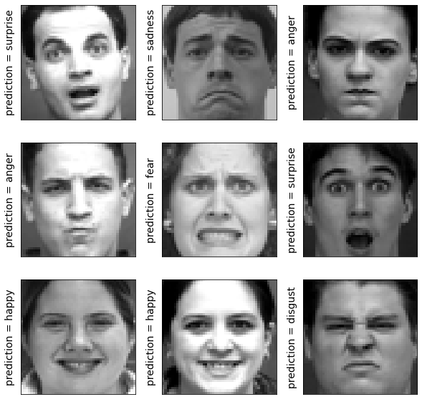
Dataset Images

Slide 7
Model Architecture
Convolutional Neural Network (CNN)
Convolution + Batch Normalization layers
Max Pooling layers
Dropout for regularization
Dense layers for classification
Softmax activation for emotion prediction

Slide 8
Training Configuration
Optimizer: Adam
Batch Size: 64
Learning Rate: 0.001
Epochs: 40–50
Loss Function: Categorical Cross-Entropy
Evaluation Metrics: Accuracy, Precision, Recall, F1-Score

Slide 9
Results and Analysis
Training accuracy improved consistently during training.
Validation loss decreased steadily.
Confusion matrix showed strong classification performance.
Minor misclassifications occurred between similar emotions.
The model achieved a balance between accuracy and efficiency.

Slide 10
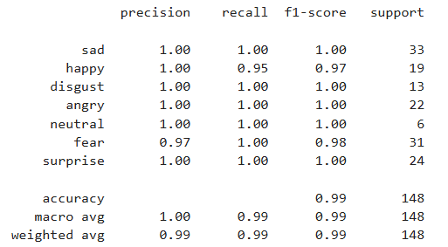
Classification Performance

Slide 11
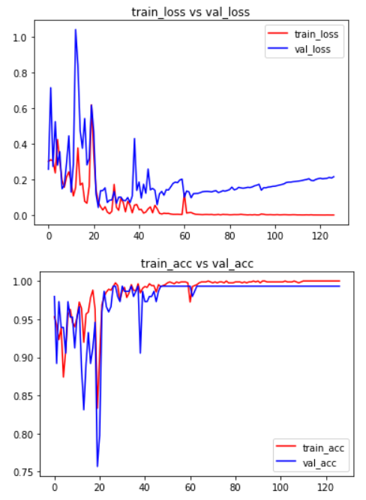
Training Accuracy Graph

Slide 12
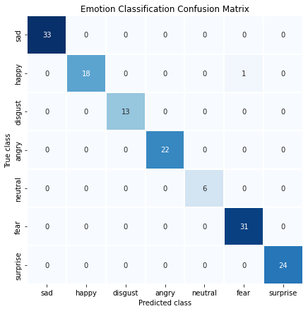
Confusion Matrix

Slide 13
Conclusion
Developed an efficient CNN model for facial emotion recognition.
Achieved strong performance on the FER-2013 dataset.
The model is suitable for real-time and resource-constrained environments.
The study highlights the importance of optimizing both accuracy and efficiency.

Slide 14
Future Scope
Real-time webcam integration
Mobile and embedded deployment
Transformer-based architectures
Multimodal emotion recognition
Advanced optimization techniques

Slide 15
Thank You

